Slide 1


Presentation AirBnb in New York
Armine NASRI SEBDANI
Group 2 – Python for Data Science
Armine NASRI SEBDANI
Groupe 2 – Python For Data Science

Slide 2

Summary
01.
02.
03.
04.
05.
Data presentation
First plot, describe…
Data Cleaning
How cleaning this dataset ?
Data Analysis
Plot and analysis
Machine Learning
Is this price is correct ?
Conclusion
What information give this dataset

Slide 3
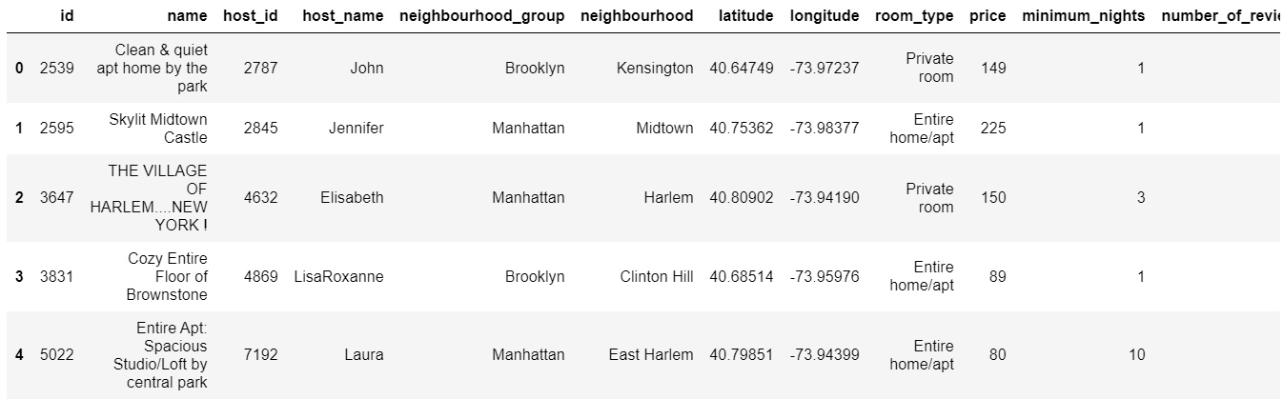
I - Data Presentation
16 columns & 48 895 rows
Many analysis possible with this datas :
a) Which are the most expensive boroughs in New York with the most expensive neighborhoods ?
b) What are the most popular types of accommodation?
c) What is the most interesting per question?
d) Ranking by district : What are the average nights by type of accommodation?
e) Who are the top 10 hosts in New York?
f) What are the correlations between the columns of the dataset ? Neighborhood and announcements
with reviews - Classification of neighborhoods

Slide 4
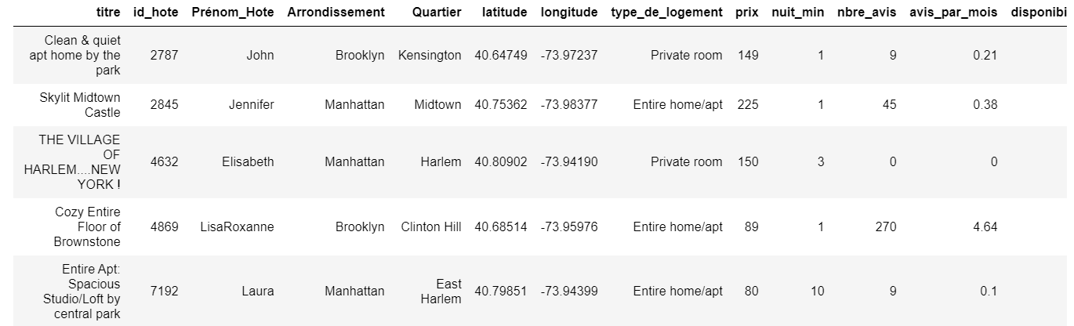
II - Data cleaning
Page 4
Drop columns last_review","calculated_host_listings_count
Replace Null value to 0 for Review_per_month column
Drop rows with price more than 2000 and equal to 0
Translate columns name in French (easier…)

Slide 5
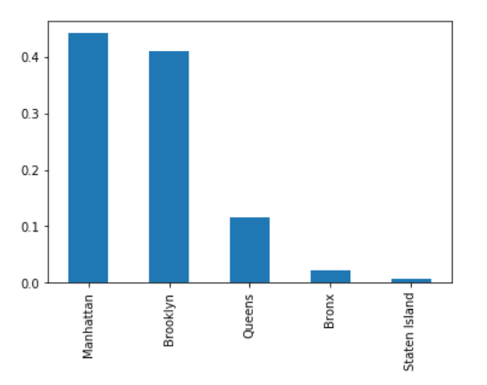
III - Data Analysis
Which are the most expensive boroughs in New York ?
Neighborhoods most represented

Slide 6
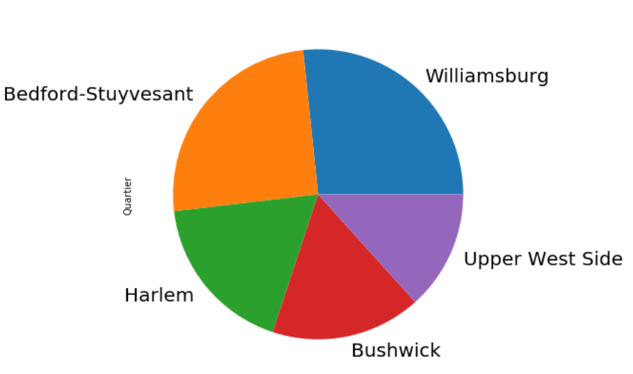
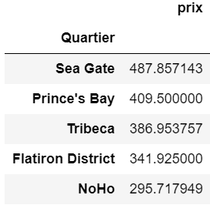
III - Data Analysis
Which are the most expensive boroughs in New York
with the most expensive neighborhoods ?
Ranking most expensive Neighborhoods
(Most of them are from Manhattan)
Woodrow and Fort Wadsworth deleted
Neighborhoods most represented
3 of them from Brooklyn

Slide 7
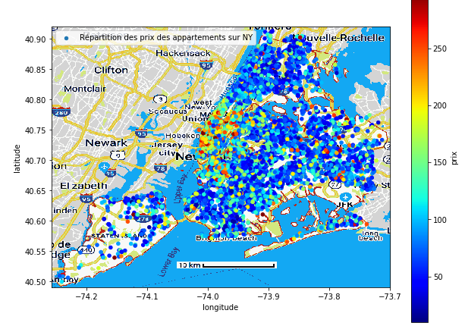
III - Data Analysis
Repartition in the
New York Map

Slide 8
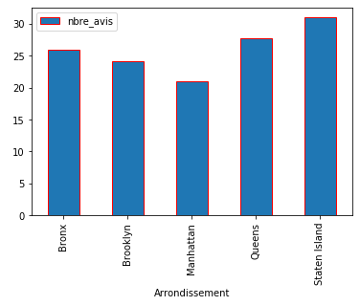
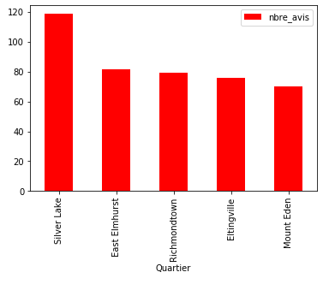
III - Data Analysis
Average number of review by rows of every neighborhoods and neighborhoods-group
Neighborhoods with most review from Staten Island et Queens

Slide 9
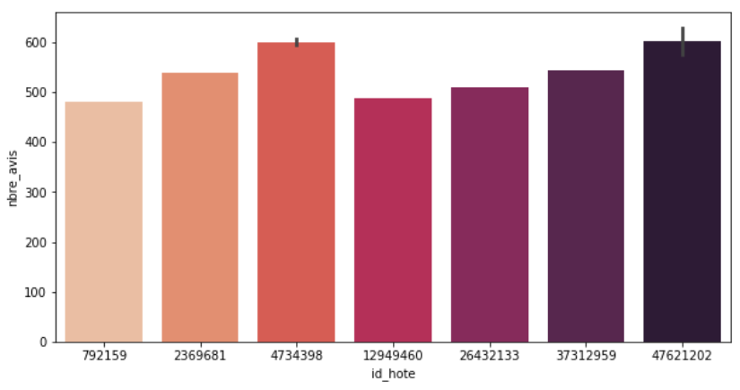
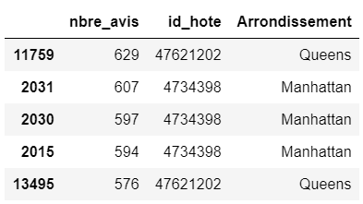
III - Data Analysis
Top 5 hosts of New York

Slide 10
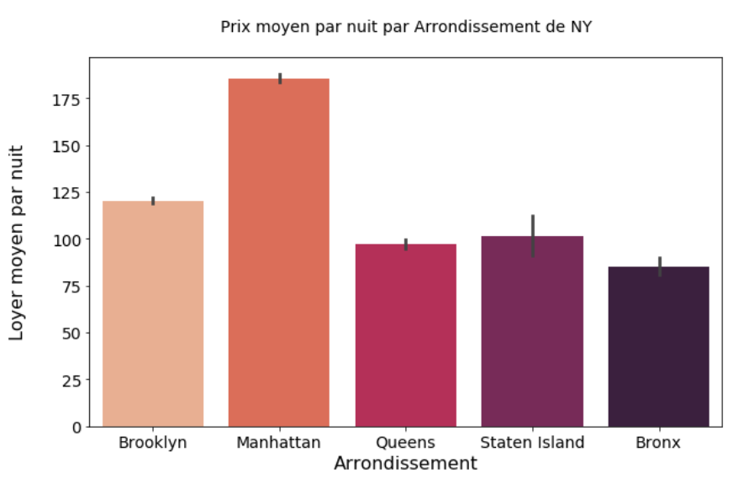
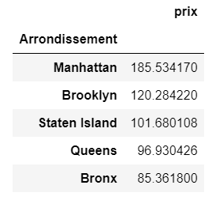
III - Data Analysis
Which is the average price by neighborhoods ?

Slide 11
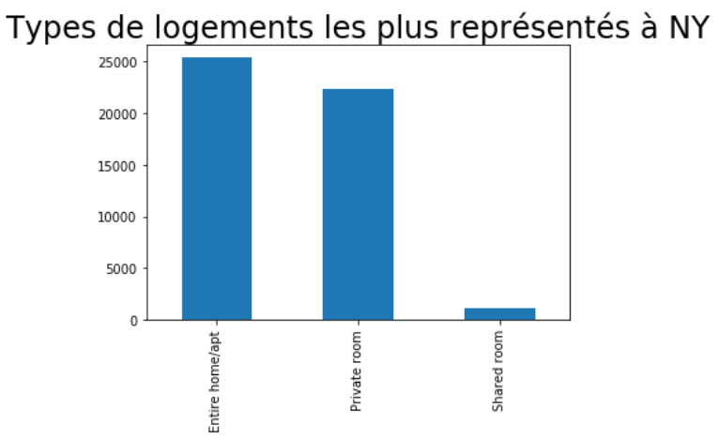
III - Data Analysis
Which are the proportion of the different type of room ?

Slide 12
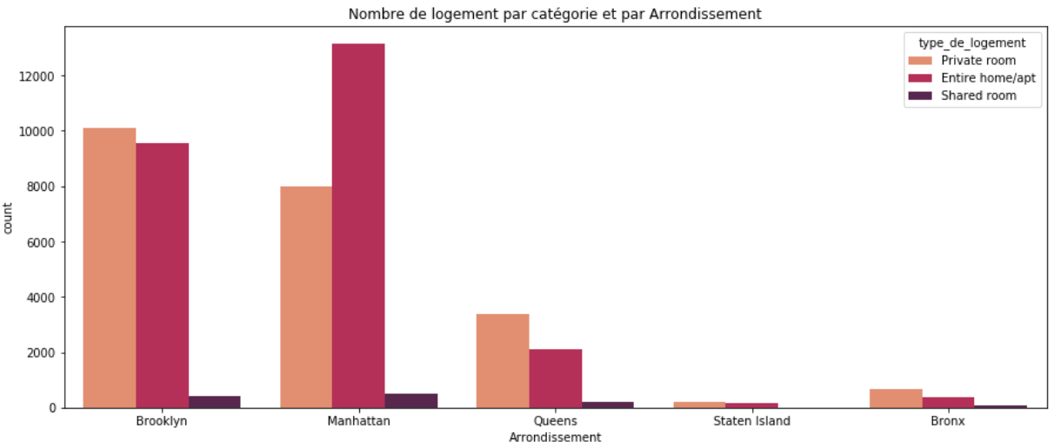
III - Data Analysis
Which are the proportion of the different type of room by neighborhoods ?

Slide 13
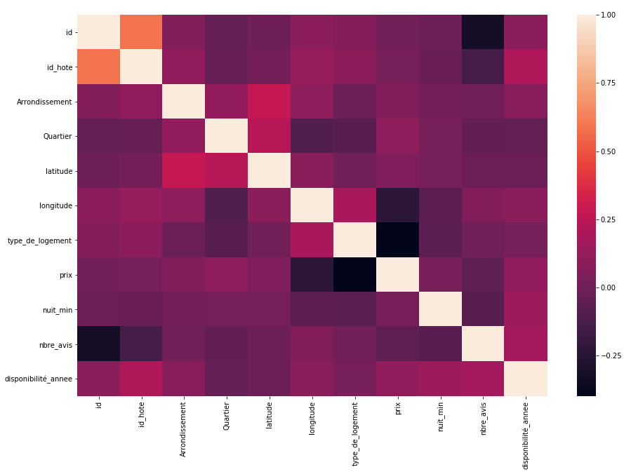
III - Data
Analysis

Slide 14
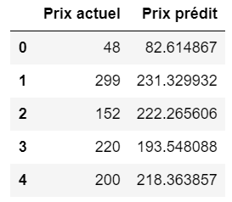
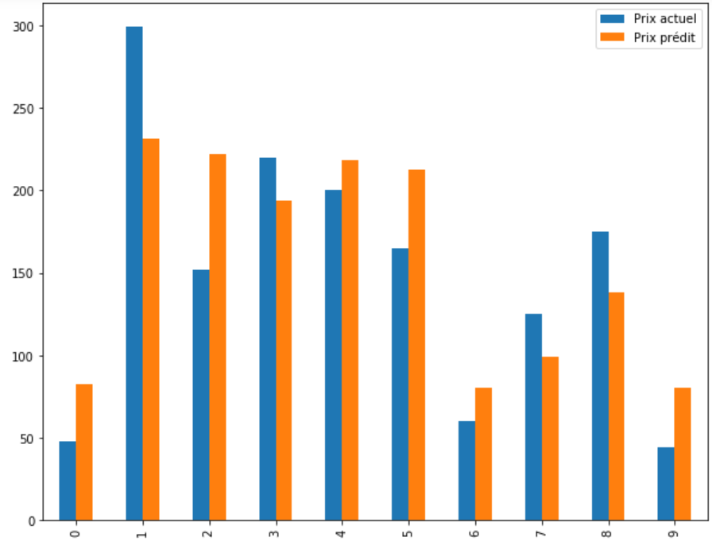
IV – Machine Learning
Goal : Predict the good price and compare with the price display on Airbnb
2 Model : Linear Regression and RandomForest
Predictor : All the columns
Prediction on : price
Precision Estimator :
MSE : 55085.01061933474
Quality prediction :
R² score : 0.12
Try to boost R with Gboost

Slide 15
New York is expensive !
IV – Conclusion
See how much NY is a touristic area
Lot of differences between neighborhoods on the price
No correlation between price and neighborhoods
Differences between predicted price and real price

Slide 16

Thank you for your listening
THANK YOU FOR YOUR LISTENING

